Slide 1


Smart Credit Card Fraud Investigation
An AI-powered fraud detection system that predicts fraudulent transactions and generates continuous risk scores to help investigators prioritise suspicious activity.
MSOC 2026 – DATA SCIENCE TRACK
DRAEV DEVS
Team: Shubham Vishwakarma · Tejas Shah
Notes:
1

Slide 2

THE PROBLEM
Traditional Fraud Detection is Failing
Banks process millions of transactions daily, yet rule-based systems cannot keep pace with evolving fraud patterns — resulting in financial losses and eroded customer trust.
High False Positives
Legitimate transactions blocked, frustrating customers
Missed Fraud
Sophisticated patterns bypass static rules
Financial Losses
Billions lost annually to undetected fraud
No Explainability
Decisions lack transparency for investigators
Notes:
2

Slide 3




OUR SOLUTION
What We Built
Smart Credit Card Fraud Investigation is an end-to-end ML system combining accurate fraud prediction with an investigator-friendly dashboard and continuous risk scoring.
ML Fraud Model
Risk Score (0–100)
Random Forest classifier trained on real transaction data for high-accuracy binary classification
Continuous scoring helps investigators prioritise the most suspicious transactions
Streamlit Dashboard
Re-trainable Pipeline
Interactive interface for CSV upload, batch prediction, and result visualisation
Model can be retrained on new datasets to adapt to emerging fraud patterns
Notes:
3

Slide 4


DATASET
Kaggle Credit Card Fraud Dataset (ULB)
A widely-used benchmark dataset for fraud detection research, featuring anonymised European cardholder transactions over two days.
284,807 Transactions
30 Input Features
Highly Imbalanced
Binary Target: Class
Real-world card transactions
Time, amount, and 28 PCA-transformed variables
Only 0.17% of transactions are fraudulent
0 = Legitimate, 1 = Fraudulent
Notes:
4

Slide 5
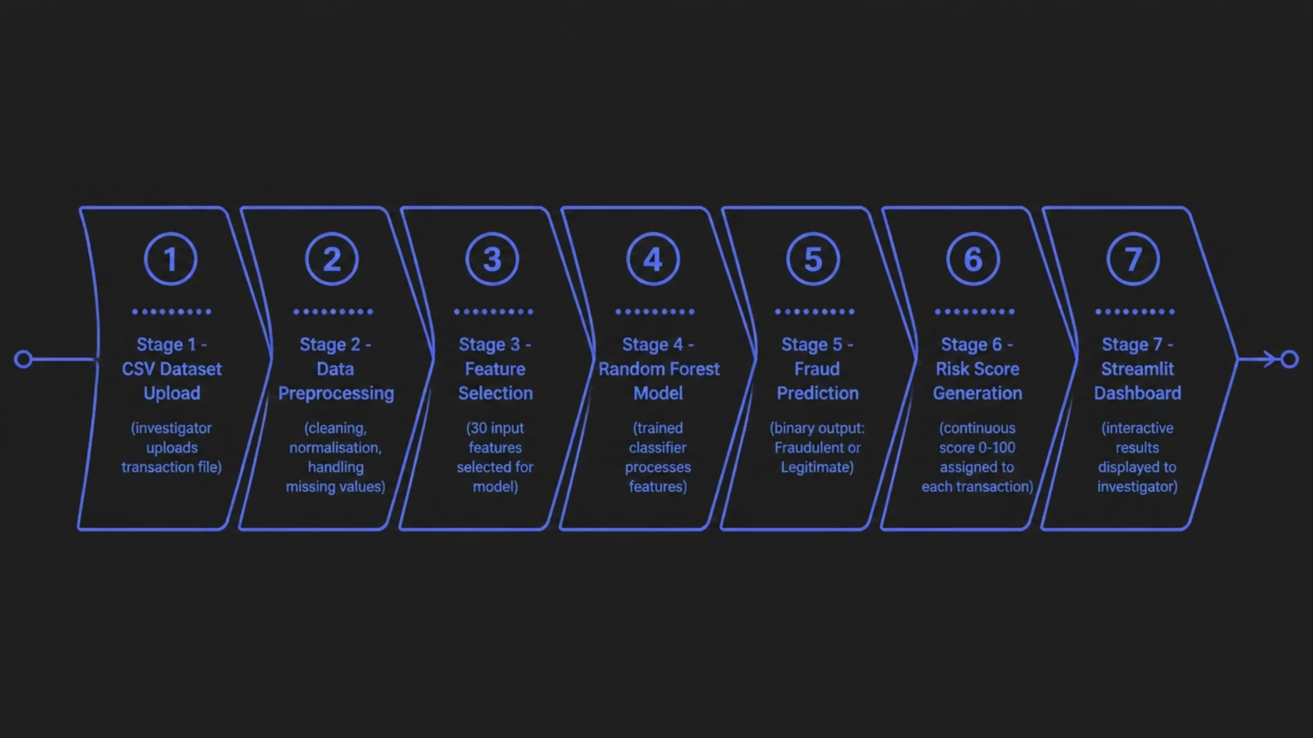
SYSTEM ARCHITECTURE
End-to-End System Workflow
From raw transaction data to actionable fraud alerts — the pipeline is designed for speed, accuracy, and investigator usability.
Notes:
5

Slide 6


MACHINE LEARNING
Why Random Forest?
The Random Forest Classifier was selected as the core algorithm for its robustness, speed, and natural handling of imbalanced datasets — making it ideal for fraud detection.
Fast Training
High Accuracy
Efficient on large transaction datasets
Ensemble approach reduces overfitting
Handles Imbalance
Easy Deployment
Performs well even with 0.17% fraud rate
Lightweight, serialisable with Joblib
Notes:
6

Slide 7

MODEL PERFORMANCE
Results on Held-Out Test Set
Evaluation metrics confirm strong discriminative performance on a held-out test set, with high precision and a competitive F1 score given the severe class imbalance.
90.59%
78.57%
Precision
Recall
Of predicted frauds, 90.59% were truly fraudulent
78.57% of actual frauds were correctly detected
84.15%
86.29%
F1 Score
PR-AUC
Harmonic mean of precision and recall
Area under the Precision-Recall curve
Confusion Matrix (Test Set): True Negatives: 56,856 · False Positives: 8 · False Negatives: 21 · True Positives: 77
Notes:
7

Slide 8
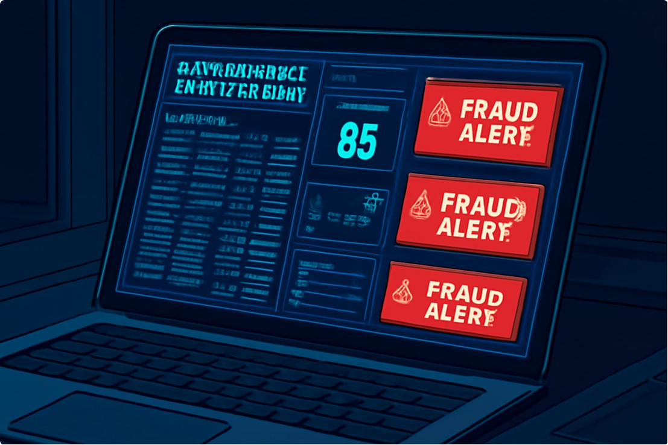


DASHBOARD
Investigator Dashboard — Streamlit
The Streamlit dashboard provides fraud investigators with a clean, intuitive interface to upload data, run predictions, and act on risk scores — no coding required.
1
2
3
CSV Upload
Fraud Prediction
Risk Scores
Upload batch transaction files for bulk analysis
Instant binary classification for each transaction
0–100 continuous score for prioritisation
Notes:
8

Slide 9


CHALLENGES & ROADMAP
What We Overcame & What's Next
⚡ Hackathon Challenges
🚀 Future Improvements
Severe class imbalance (0.17% fraud rate)
Compressed timeline for model optimisation
Real-time fraud detection via API
Explainable AI using SHAP values
Fast deployment under constraints
Designing a practical investigator workflow
Live transaction monitoring pipeline
Fraud ring & network detection
Cloud deployment with auto-retraining
Notes:
9

Slide 10

CONCLUSION
Scalable. Practical. Ready for the Real World.
Smart Credit Card Fraud Investigation demonstrates how machine learning can help financial institutions detect fraud efficiently — combining strong model performance with an investigator-friendly dashboard and a re-trainable pipeline built for the future.
90.59% Precision
Minimal false alarms
Risk Scores
Actionable prioritisation
Re-trainable
Adapts to new patterns
Dashboard Ready
No-code investigator tool
Draev Devs — Shubham Vishwakarma · Tejas Shah · MSoC 2026 – Data Science Track
Notes:
10

